Slide 1
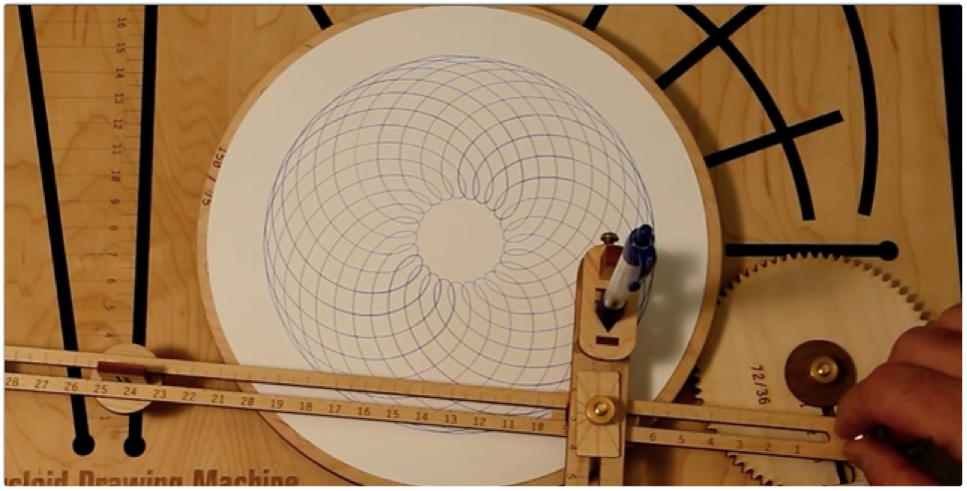
Spirograph machine
Margaret Baxter & Christine Russell

Slide 2
Our project
Designing and building a custom spirograph machine
Using MATLAB to design the linkage and gear movement
Using OpenSCAD to design the actual gears, linkages and connectors
Printing gears, linkages and connectors on Form 2 printer

Slide 3
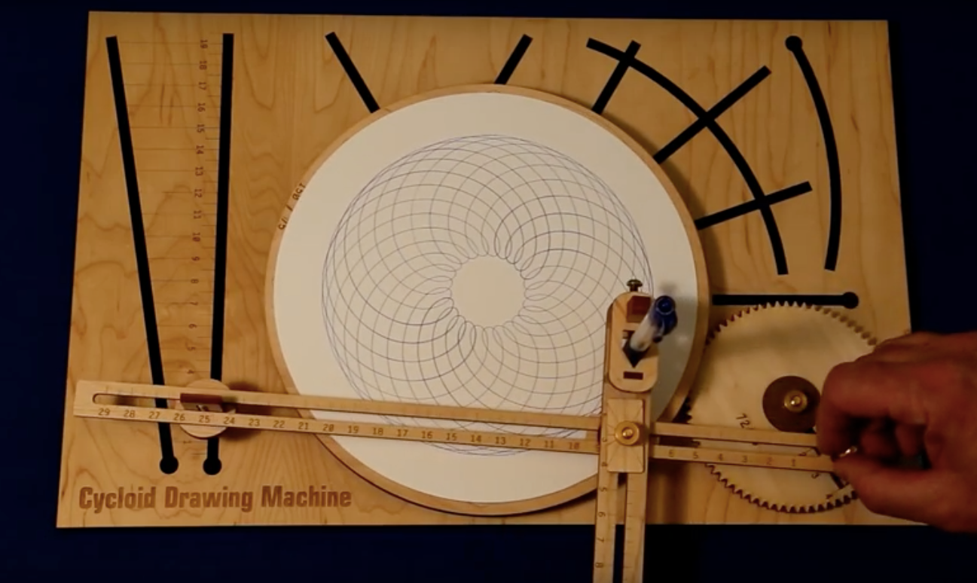
our inspiration

Slide 4
Technical Challenges
Drawing tracing particles on a moving turntable in MATLAB so we can see the pattern we are drawing with our current set-up.
Determining reasonable size for all the parts to both prevent breakage and not waste resources.
Making sure they do not have to be resized in FormLabs software, as that would alter parts like the pen holder where they would no longer fit.
Making the board reconfigurable so the user can draw more than just one pattern.

Slide 5
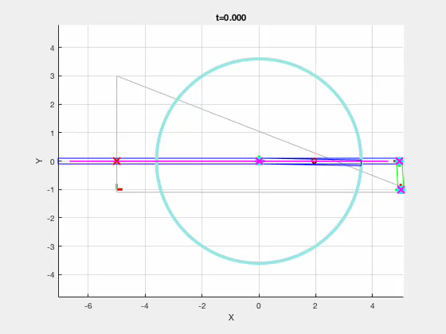
What we have done so far
Created the necessary moving gears and linkages in MATLAB and can trace the final drawing.

Slide 6
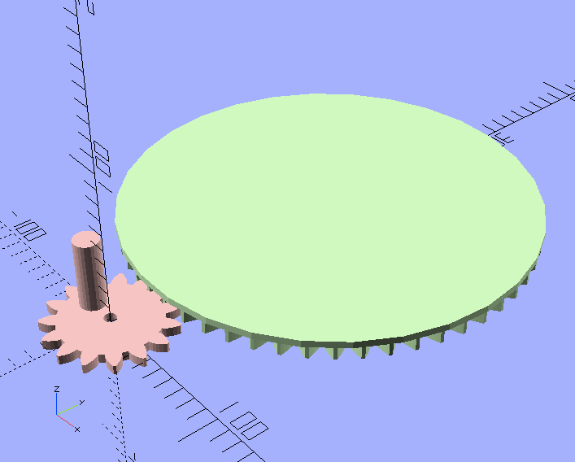
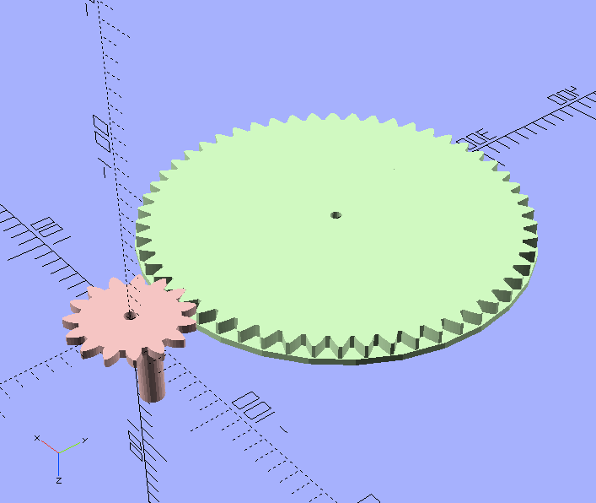
What we have done so far
Began drawing the different pieces in OpenSCAD using a public domain parametric OpenSCAD script for generating parameterized gears.

Slide 7
what we still need to do
Create different configurations for the gears to draw different pictures
Draw slider and straight linkages in OpenSCAD
Determine the scale between OpenSCAD drawings and what will print on FormLabs printer
Take measurements for pen and pegs to plug into OpenSCAD drawings; or print our own pegs on each piece

Slide 8
resources
Public Domain Involute Parameterized Gears http://www.thingiverse.com/thing:5505

